Slide 1

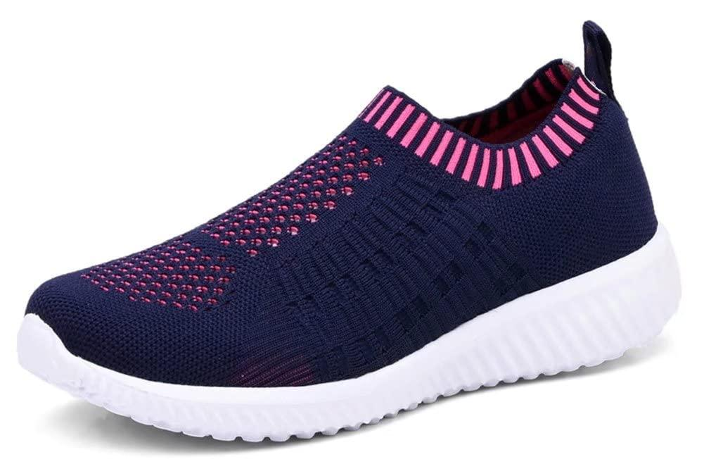

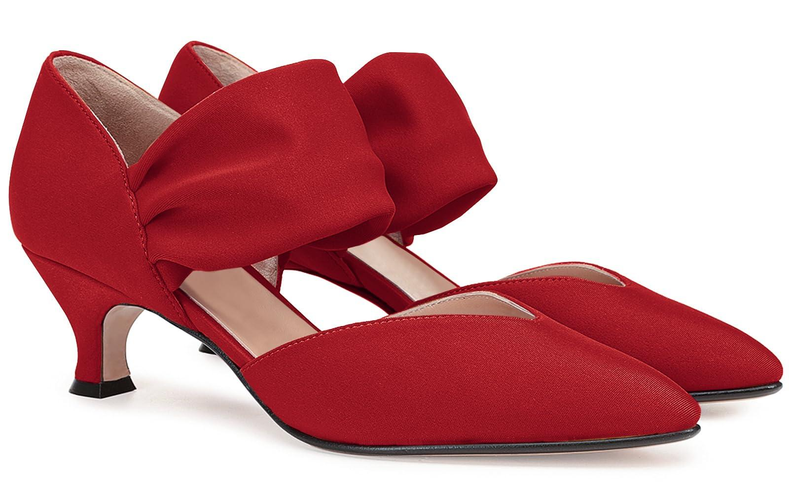
Dynamic Demand Modeling using Multimodal AI
By:
Jyoti Karna| Billy Saputra | Yin Yuhui | Ladityarsa Ilyankusuma
Advisor:
Guy Arie, PhD | Ruidong Ma, PhD

Slide 2
TABLE OF CONTENTS
01. Data Scraping
03. COLOR
05. PHOTOGRAPHY
07. GRID SYSTEM
Brand Principles
Palette
Application
Examples
Layouts
Examples
02. TYPOGRAPHY
04. LOGO
06. ICONOGRAPHY
THANK YOU
Work Sans
Construction
Color Use
Do’s & Don’ts
Icon Build
Library
Cymbal
Visual Identity Guidelines
Month 20XX

Slide 3
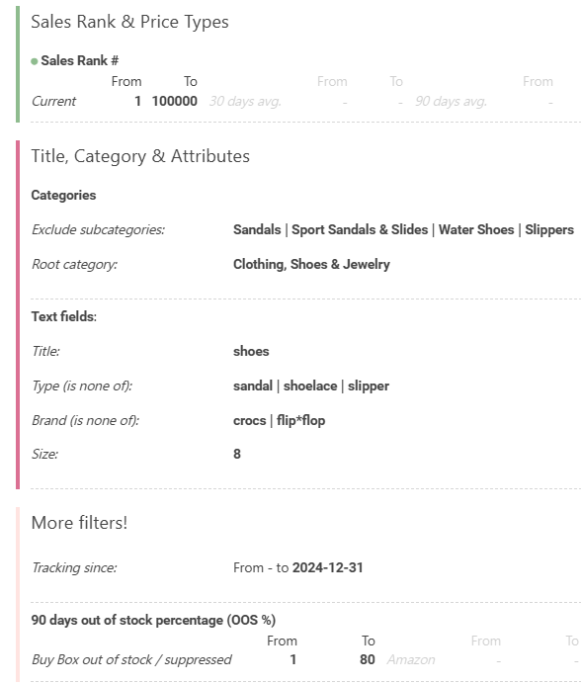

Data Scraping
January 2025 - March 2026
Downloading batch base on ranking:
Batch 1 = 1 - 10k
Batch 2 = 10k - 20k
Batch 3 = 20k - 30k
Batch 4 = 30k - 40k
Batch 5 = 40k - 60k
Batch 6 = 60k - 80k
Batch 7 = 80 - 100k
Shape : (1,008,930, 26)
Total Unique ASINs : 7,761
Women : 5,472 (70.5%)
Men : 2,279 (29.4%)

Slide 4
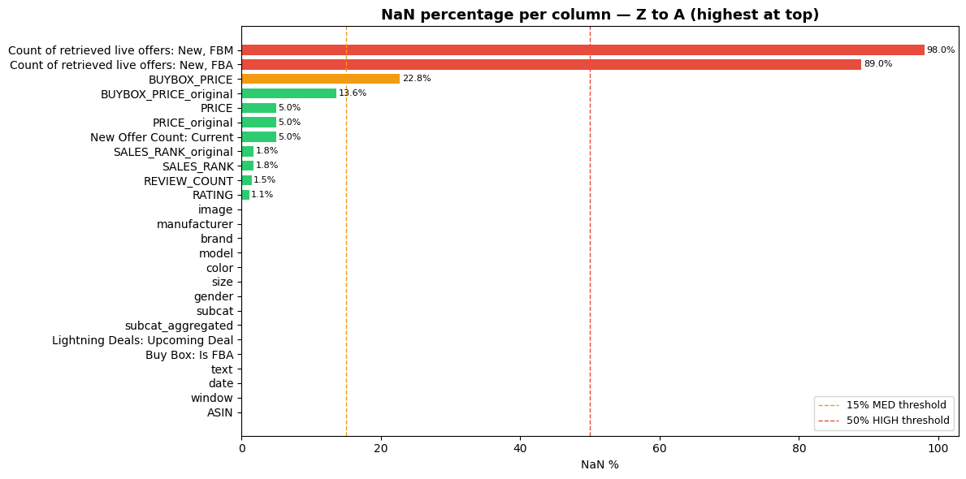
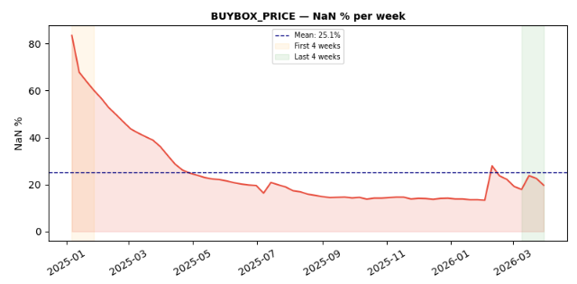
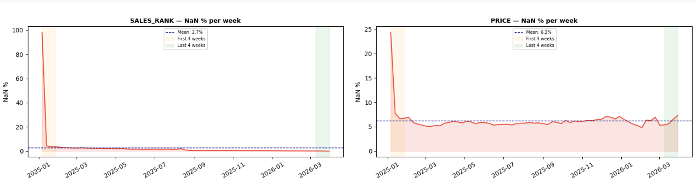
Exploratory Data Analysis (EDA)
NaN Value Distribution -> Remove January - February 2025

Slide 5
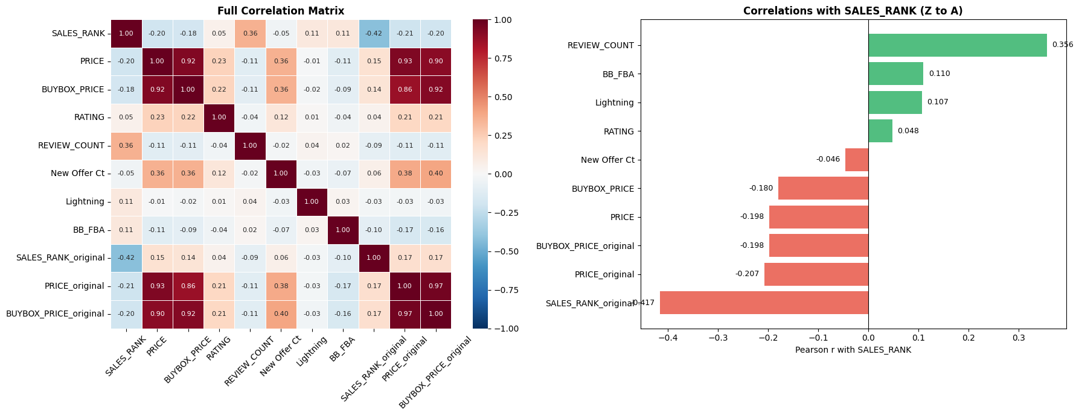
Exploratory Data Analysis (EDA)
Weak correlation -> Need future selection for next step

Slide 6
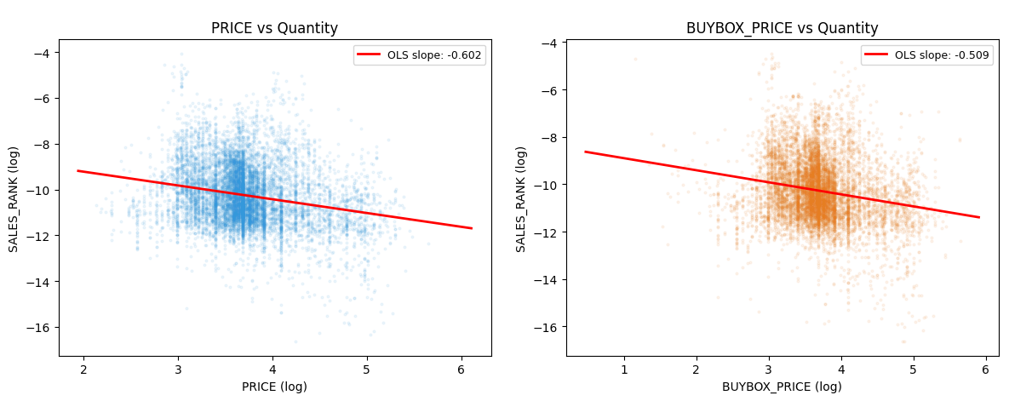
Exploratory Data Analysis (EDA)
Price vs Quantity Relationship (Core for Demand Estimation)
Ordinary Least Squares (OLS) —> fits the best straight line to show the raw price-demand relationship
Slope -0.602 (PRICE) | Slope -0.509 (BUYBOX_PRICE)
However, OLS captures correlation, not causation, so we use DoubleML later to isolate the true causal effect

